Slide 1
Psychological Aspects of Drivers
Approaching Level Crossing.
Using Scientific Methodology and Creativity
to Improve Safety
Michael H. Cale’
Israel Railways and CogniTo Ltd. 2011

Slide 2
Boring
The danger

Slide 3
Boring
The danger in huge letters

Slide 4
Boring !
The danger in huge letters and a real exclamation mark

Slide 5
The danger using dynamic graphics

Slide 6
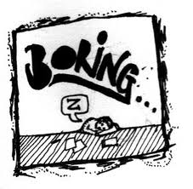
The danger and what it might lead to using a drawing

Slide 7
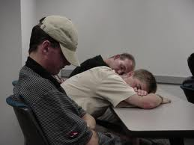
The danger and what it might lead to using real images

Slide 8
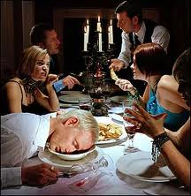
The danger and what it might lead to at the dinner table

Slide 9
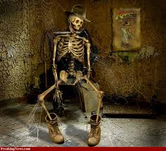
Explaining the danger and what it might lead to using extreme intimidation tools

Slide 10
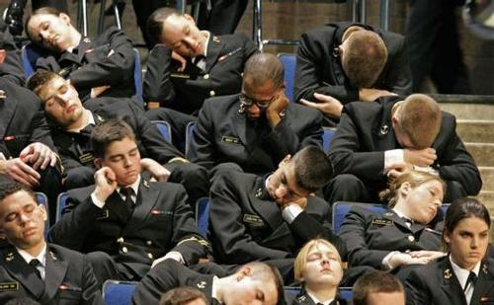
My lecture last week

Slide 11
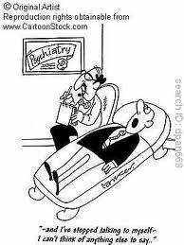
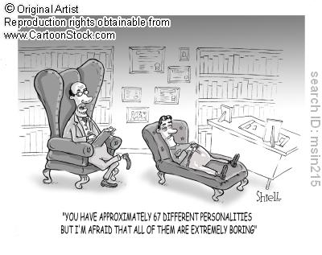
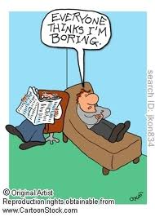
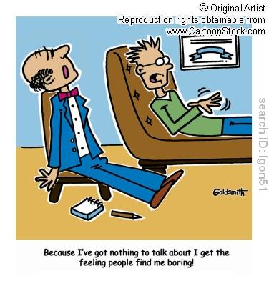
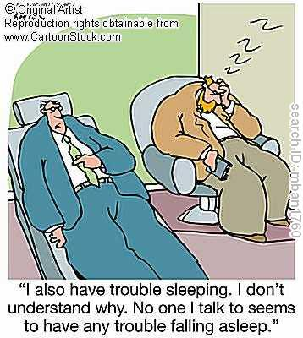
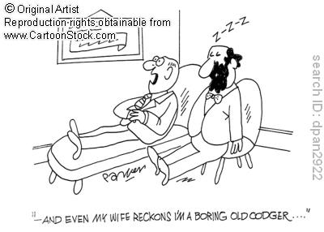
The danger in the field of clinical psychology

Slide 12
A natural solution to the danger

Slide 13
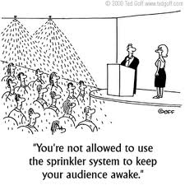
A technical solution to the problem

Slide 14
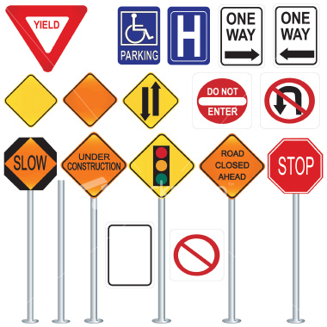
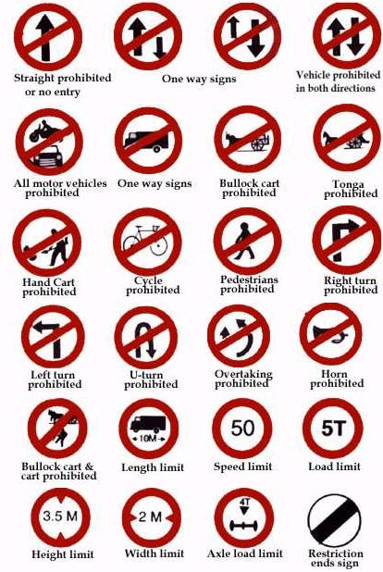
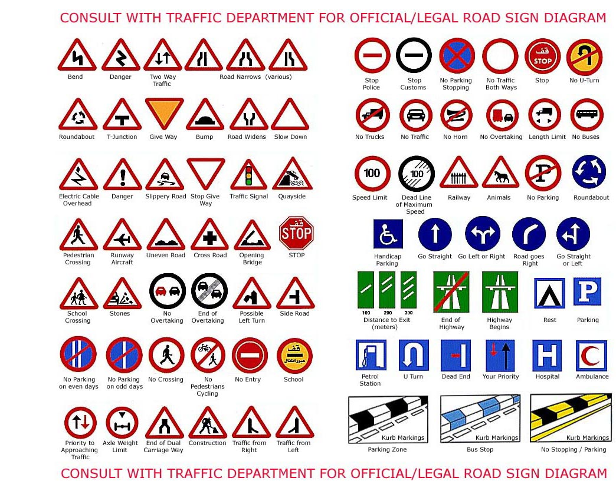
What kind of a solution is this ?

Slide 15
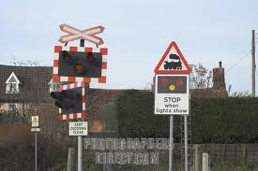
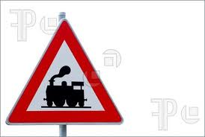
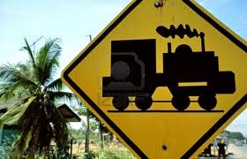
Or this ?

Slide 16
Let’s be serious
1. What is the danger ?
2. Why is there a danger ?
3. What can we do to prevent the danger ?

Slide 17
1. What is the danger ?
Behavior at level crossings | Psychologists’ lectures
Destroying the barrier | Falling asleep
Crashing with train | Not understanding the material
Following vehicle(s) may crash with train | Looking like an idiot when you nod off
Causing the train to derail ( catastrophe ) | Wasting your time and travel budget

Slide 18
2. Why is there a danger ?
Behavior at level crossings | Psychologists’ lectures
Lack of attention | Shrinks are really boring
Fatigue | Jet lag
Autopilot | Great bar in the hotel
High speed | Shrinks are even more boring
Disorientation / Confusion | Language problems
Solution for Visual Illusions ( + / - ) | You know…

Slide 19
3. What can we do to prevent the danger ?
Behavior at level crossings | Psychologists’ lectures
Solution for lack of attention | Use matchsticks
Solution for Fatigue | Use humor
Solution for Autopilot | Surprise noise (Haydn)
Solution for High speed | Have neighbor take notes and go to the pool
Solution for Disorientation and Confusion | Bribe the audience to stay awake
Visual Illusions ( + / - ) | Attack conference organizers
Offer something worth while | Offer something worth while

Slide 20
The Israeli picture:
95 level crossings
Just over 1000 kilometers of tracks
400 barriers broken per annum
During 2010 there were six accidents with seven fatalities

Slide 21
The Process
1. Extensive search of the empirical literature
2. Develop and Present a list of proposals
3. Combine list of “scientific” proposals with a list of suggestions deriving from current work at Israel Railways
4. Develop a photo realistic simulator to study the effectiveness of each proposal before implementation
5. Implement the tools which have been empirically proven to be valid and effective

Slide 22
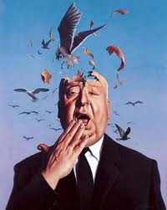
One prerequisite
Open your mind
and lock all rules, regulations and common beliefs away

Slide 23
One Assumption
There are two types of reasons for dangers:
a. Problems in concentration, perception or cognition (driver makes an error)
b. Problems of attitude, motivation and social pressure (driver opts for dangerous behavior )

Slide 24
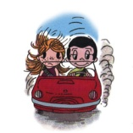
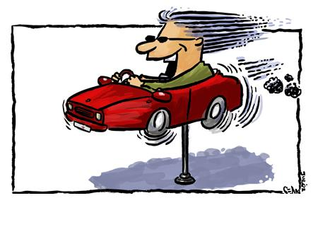
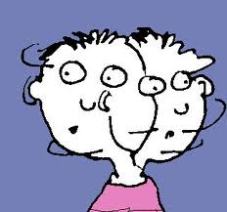
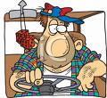
Suggestions and proposals aimed at alleviating problems in concentration, perception or cognition e.g.
Split attention (e.g cell phones)
Competing Stimuli ( e.g. passengers or advertisements )
Fatigue ( “the number one killer”)
Confusion (“normal” or based on pathological processes )
Alcohol
Underestimation of speed
AD(H)D
Other problems of attention and concentration (e.g. boredom )

Slide 25
Source | Proposed Changes - Literature Based ( 1 )
Cale’ (2006,2011) | Lines with reducing distances when approaching barrier | 1
Cale’ (2006) | Create illusion of bottleneck using paint on road surface | 2
Bowman (1987) | Illusion of moving lights (move slowly towards crossing when no train approaches and away when train approaches ) | 3
Chien-lung (2010), Bowman( 1988) | Two active signs. 100x150 one hundred meters and 150x200 fifty meters from the barriers ( option: check effectiveness on both sides of road ) | 4
Kattack & McNight (2007) | Flexible rubber poles (50 cm height) between lanes 40 meters before barriers | 5
Witte & Donnehue (2007) | Huge LCS screen which works when barrier is closed and gives information: Date, time, temperature, speed of approaching train, braking distance and real news | 6

Slide 26
Source | Proposed Changes - Literature Based ( 2 )
Davey (2008) | Huge LCD as 6 but gives picture of vehicles waiting (feeling of big brother) and personal message | 7
Davey (2008) | As 7 but early active warning “active police surveillance ahead” | 8
Geller ,(2005), Cialdini (2008) | As 8 plus positive group information ( in the last week x% of the drivers waited safely at this crossing | 9
Cale(2009) | Three thin, flexible pipes 50, 100 and 150 meters from the barrier which produce 60db noise (wakeup) | 10

Slide 27
Proposed Changes - Experience Based ( 1 )
Most items will be tested using normal or bright, fluorescent paints | 1
Lines if “cat’s eyes” which produce 60,70 or 80db when an average car passes | 2
Similar to the LCD screen suggestion ( 1.9) but indicating number of drivers who were punished for not abiding to the regulations during the last month | 3
As proposal above ( 2.3) but with large, active warning sign “ level crossing with police surveillance ahead” 100 meters before crossing | 4
“Normal” traffic light 24 meters before the crossing | 5
Regulatory speed bumps with reflectors 30 meters before the crossing. Two color / brightness options | 6
Speed bumps which are 10% higher than regulations with reflectors 30 meters before the crossing. Two color / brightness options | 7

Slide 28
Proposed Changes - Experience Based ( 2 )
Changing the appearance of the level crossing. 30 meters of the approach will be painted light blue with yellow boundaries (Japanese model ) | 8
Changing the appearance of the level crossing. 30 meters of the approach will be painted light blue with yellow boundaries and the rail area bright green (Japanese model ) | 9
As above ( 2.9) with a 3x3 meter pictogram of a train in red on the light blue surface | 10
Giving the barriers and warning signs a black frame (supposedly to prevent problems when blinded by sun ) | 11
Covering the poles of sign posts in the area of the crossing with red/white padding | 12
Adding reflectors to the stopping line | 13

Slide 29
Suggestions and proposals aimed at alleviating problems of attitude, motivation and social pressure (driver opts for dangerous behavior )
Why do people chose to put themselves in danger ?
Old Question
Two Answers

Slide 30
Why do people chose to put themselves in danger ?
1. Risk Homeostasis ( Wilde 2001, Cale’ 2006)
Goodbye intuition !

Slide 31
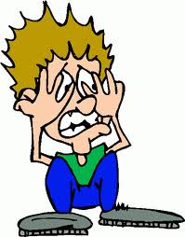
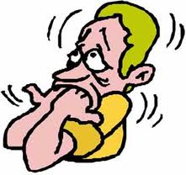
1. Risk Homeostasis ( Wilde 2001, Cale’ 2006)
Main lesson :
Emphasizing dangers or even improvements just might make things worse !

Slide 32
Why do people chose to put themselves in danger ?
2. ‘ cause it must be worth while ( Cale 2006 )

Slide 33
2. ‘cause its worth while ( Cale’ 2006 )
Main lesson :
You might be better off making him an offer, he can’t refuse rather than threatening him

Slide 34
Psychological Aspects of Drivers
Approaching Level Crossing.
Using Scientific Knowledge and Creativity to Improve Safety
Michael H. Cale’
Israel Railways and CogniTo Ltd. 2011
…hoping it wasn’t too boring….

